Slide 2
Outline
Proving systems
Use cases and applications
Demystifying STARKs
STARK-based virtual machines

Slide 3

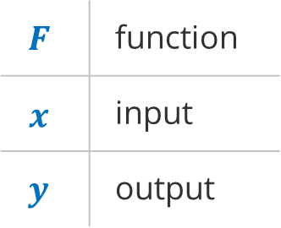

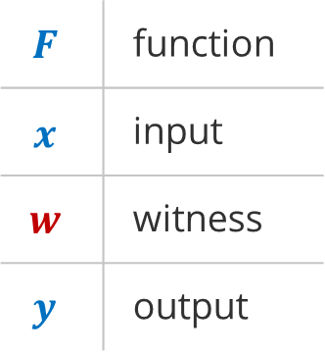

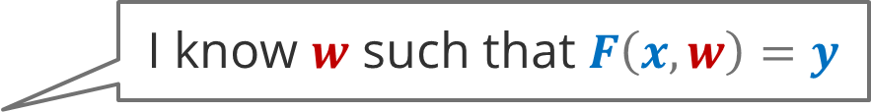

Proofs of computational integrity
I know $w$ such that $F\left(x, w\right)=y$
Prover
$$F$$ | function
$$x$$ | input
$$w$$ | witness
$$y$$ | output
Verifier
$$F$$ | function
$$x$$ | input
$$y$$ | output
Proof $π$
$O\left(\log^{k}n\right)$ or $O\left(1\right)$
$$O\left(n \log^{k}n\right)$$
$O\left(n\right)$or $O\left(\log^{k}n\right)$ or $O\left(1\right)$
$F$ can be any Turing-complete computation!

Slide 4
Proving systems
Succinct verifier
Transparent
Halo
2019
Spartan
2019
Groth16
2016
Bulletproofs
2017
SuperSonic
2019
PLONK
2019
Fractal
2019
Pickles
2020
Marlin
2019
Aurora
2018
STARK
2018
Sonic
2019
Ligero
2017
Post-Quantum

Slide 5
Proving system comparison
 | Setup | Proof size | Prover speed | Verifier speed | Crypto assumptions
Groth16 | Trusted, per-circuit | 0.2 KB | Fast | Very fast | Novel
PLONK | Trusted, universal | 0.5 KB | Fast | Very fast | Novel
Marlin | Trusted, universal | 0.8 KB | Medium | Fast | Novel
Bulletproofs | Transparent | 2 KB | Medium | Linear | Established
Halo | Transparent | 4 KB | Medium | Linear | Established
Spartan | Transparent | 50+ KB | Fast | Fast | Established
Fractal | Transparent | 80+ KB | Slow | Fast | Minimal
STARKs | Transparent | 50+ KB | Very fast | Very fast | Minimal

Slide 6
SNARKs and STARKs
STARKs
SNARKs
Scalable
Non-interactive STARKs
Succinct
Transparent
Non-interactive
Scalable
Transparent SNARKs
Arguments of
Arguments of
Knowledge
Knowledge

Slide 7

Arithmetization
$$F\left(x, w\right)=y$$
Circuit computation
Most SNARKs
Machine computation
STARKs
Arithmetization
Rank 1 Constraint Satisfiability (R1CS)
Arithmetization
Algebraic Intermediate Representation (AIR)

Slide 8








R1CS arithmetization
Program
Algebraic circuit
R1CS
s
$$A=$$
0, 1, 0, 0
0, 0, 1, 0
42, 0, 0, 1
function foo(n, s) {
let r = s;
for i in 0..n {
r = r^3 + 42;
}
return r;
}
$$x^{3}$$
$$+42$$
0, 1, 0, 0
0, 1, 0, 0
1, 0, 0, 0
$$B=$$
n
times
$$x^{3}$$
$$+42$$
0, 0, 1, 0
0, 0, 0, 1
106, 0, 0, 1
$$C=$$
r
$$A∗z∘B∗z=C∗z$$

Slide 9




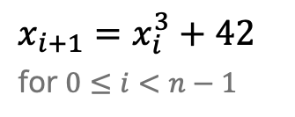


AIR arithmetization
Program
Execution trace
AIR
function foo(n, s) {
let r = s;
for i in 0..n {
r = r^3 + 42;
}
return r;
}
$$x_{0}=s$$
$x_{i+1}=x_{i}^{3}+42$
for $0≤i<n−1$
$$x_{1}=x_{0}^{3}+42$$
$$x_{2}=x_{1}^{3}+42$$
…
n
steps
…
$x_{i}=s$ for $i=0$
…
…
$x_{i}=r$ for $i=n−1$
$$r=x_{n−2}^{3}+42$$

Slide 10
Arithmetization comparison
 | R1CS | AIR
Native Arithmetic | Finite fields | Finite fields
Well-suited for | Unstructured computations | Uniform computations
Composability | Relatively easy | Difficult
Compilation from higher-level languages | Moderately difficult | Difficult
Supports unbounded computations | No | Yes

Slide 11
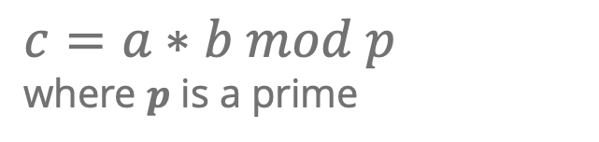
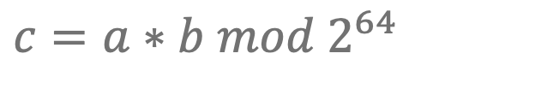
Arithmetization-friendly computations
Native CPU arithmetic
$$c=a∗b mod 2^{64}$$
Expensive operations for ZKPs:
Non-native arithmetic: requires bound-checking inputs and outputs
Less than, greater than comparisons: requires binary decomposition
Bitwise operations: AND, OR, XOR, bit shifts etc.
Native ZKP arithmetic
$$c=a∗b mod p$$
where $p$ is a prime

Slide 12
Challenges
Proving overhead
Proof generation is expensive
100x overhead for arithmetization-friendly computations
10,000x overhead for arithmetization-hard computations
Solutions
Arithmetization-friendly cryptographic primitives
Lookup tables (PLOOKUP)
Concurrent proof generation
Hardware acceleration
Arithmetization complexity
Efficient arithmetization is hard
Manual arithmetization is infeasible for anything but the simplest computations
Naïve automated arithmetization is possible but not practical
Solutions
Higher-level languages and compilers (especially for R1CS)
Zero-knowledge virtual machines (especially for AIR)

Slide 13
Outline
Proving systems
Use cases and applications
Demystifying STARKs
STARK-based virtual machines

Slide 14
Applications
Proofs of computational integrity
Scalability
Make things smaller and faster to verify
Privacy
Keep data and computations hidden

Slide 15
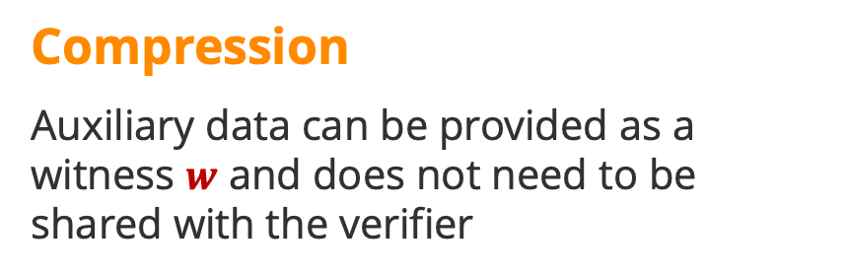
Scalability
Compression
Auxiliary data can be provided as a witness $w$ and does not need to be shared with the verifier
I have verified 10,000 signatures and here is a 200-byte proof that they are all correct.
No re-execution
Once a proof is generated, verifying it is exponentially faster than re-executing the computation*
*requires succinct proving system
I have executed 10,000 transactions and here is a proof that the results are correct. You can verify it in 10 ms on a mobile phone.

Slide 16
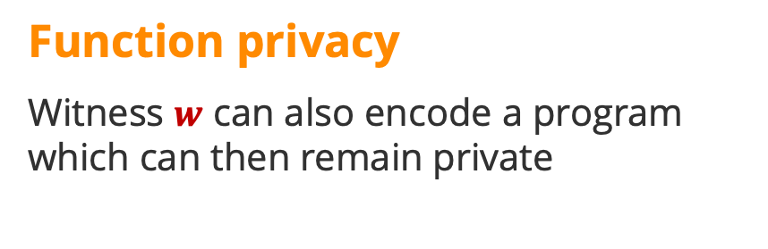
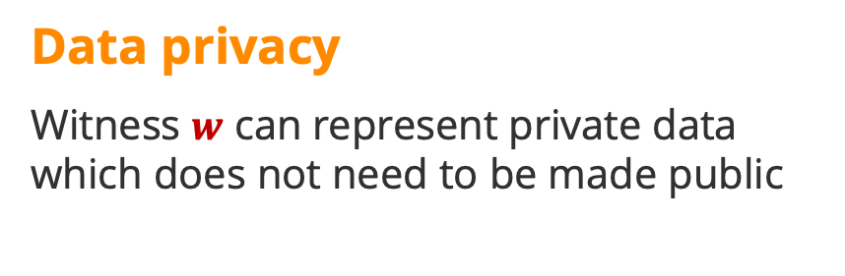
Privacy
Data privacy
Witness $w$ can represent private data which does not need to be made public
This transaction does not create or destroy any new money, but you don’t need to know the amounts involved.
Function privacy
Witness $w$ can also encode a program which can then remain private
I’ve executed some code which hashes to 0x12435… and here is the result. You can verify that the result is correct, but you don’t need to know what the code does.

Slide 17
Outline
Proving systems
Use cases and applications
Demystifying STARKs
Execution trace
Low-degree extensions
Constraint evaluation
FRI
STARK-based virtual machines

Slide 18
STARK advantages
Transparent
No trusted setup, no preprocessing
Performance
Super-light verifier:
2 – 5 ms verification for most proofs
Succinct computation description
Very fast prover:
15K zk VM* cycles / sec on a single CPU core
Massively parallelizable: up 400K cycles / sec on 64 CPU cores
* Using Miden VM
Lean cryptography
Need only collision-resistant hash function → post-quantum secure
Flexible
Work in many different fields
Prover-time vs. proof size trade-off
Security level vs. proof size trade-off

Slide 19
STARK disadvantages
Proof size
Dozens of kilobytes:
~15KB for preimage of Rescue hash function
~120KB for 1M cycles of virtual machine execution
Limited recursion
Recursion is possible but not demonstrated yet
Arithmetization*
AIR arithmetization is more complicated than R1CS
Tools to address this are in development

Slide 20
STARK proof generation
r₀
r₁
r₂
r₃
d₀
d₁
d₂
d₃
d₄
C(x)
1
2
3
4
r₀
r₁
r₂
r₃
Low Degree Extension
Constraint Evaluation
Constraint Composition
FRI Protocol
Execution Trace
Extended Execution Trace
Constraint Evaluations
Composition Polynomial
Low-Degree Proof
Commit
Commit
Query
STARK Proof

Slide 21
Outline
Proving systems
Use cases and applications
Demystifying STARKs
Execution trace
Low-degree extensions
Constraint evaluation
FRI
STARK-based virtual machines

Slide 22
Execution trace: general idea
Define state transition logic for the computation (i.e., transition function).
Execute the transitions function for n number of steps.
Record the result of the transition function at every step of the computation.

Slide 23
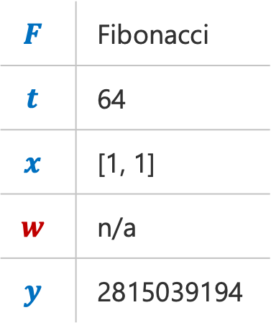
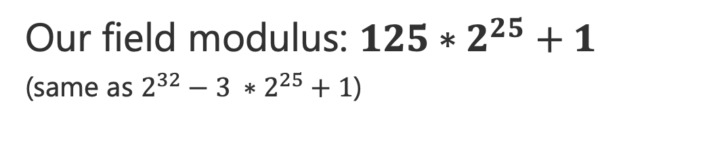
Fibonacci example
Compute 64th term of the Fibonacci sequence in a 32-bit prime field
Prover
$$F$$ | Fibonacci
$$t$$ | 64
$$x$$ | [1, 1]
$$w$$ | n/a
$$y$$ | 2815039194
Our field modulus: $125∗2^{25}+1$
(same as $2^{32}−3 ∗2^{25}+1$)

Slide 24
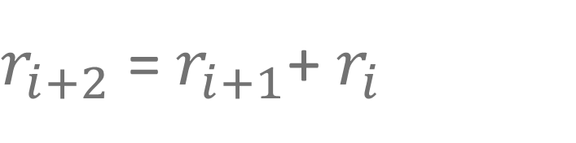
Fibonacci execution trace
$r_{i+2}$ =${ r}_{i+1}$+ $r_{i}$
Step | r
0 | 1
1 | 1
2 | 2
3 | 3
4 | 5
5 | 8
6 | 13
7 | 21
… | …
63 | 2815039194
Trace parameters
Registers: 1
Computation steps: 64
Field modulus: 125 * 2²⁵ + 1

Slide 25
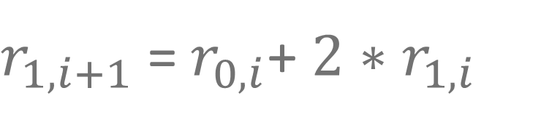
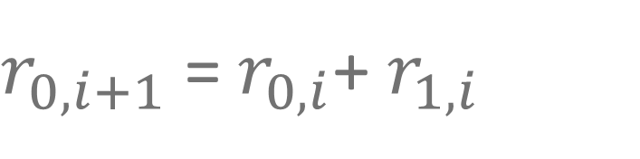
Fibonacci execution trace
$r_{0,i+1}$ =${ r}_{0,i}$+ $r_{1,i}$
Step | r₀ | r₁
0 | 1 | 1
1 | 2 | 3
2 | 5 | 8
3 | 13 | 21
4 | 34 | 55
5 | 89 | 144
6 | 233 | 377
7 | 610 | 987
… | … | …
31 | 1773166279 | 2815039194
$r_{1,i+1}$ =${ r}_{0,i}$+ $2∗r_{1,i}$
Trace parameters
Registers: 2
Computation steps: 32
Field modulus: 125 * 2²⁵ + 1

Slide 26
Outline
Proving systems
Use cases and applications
Demystifying STARKs
Execution trace
Low-degree extensions
Constraint evaluation
FRI
STARK-based virtual machines

Slide 27
LDE: general idea
Interpret each register trace as evaluations of some polynomial f(x)
Interpolate f(x) over a trace domain D_{trace}
Evaluate f(x) over a larger evaluation domain D_{lde}

Slide 28

LDE example
D_{trace} | r₀
x₀ | y₀
x₁ | y₁
x₂ | y₂
x₃ | y₃
y₀
y₂
f(x)
y₁
y₃
$$\text{deg}\text{(}\text{f}\text{(}\text{x}\text{)) = |}D_{trace}\text{| − 1}$$
x₀
x₁
x₂
x₃

Slide 29
LDE example
D_{lde} | r'₀
x'₀ | f(x’₀)
x'₁ | f(x’₁)
x'₂ | f(x’₂)
x'₃ | f(x’₃)
x'₄ | f(x’₄)
x'₅ | f(x’₅)
x'₆ | f(x’₆)
x'₇ | f(x’₇)
y₀
y₂
f(x)
y₁
y₃
x'₀
x'₁
x’₂
x’₃
x’₄
x’₅
x’₆
x’₇

Slide 30




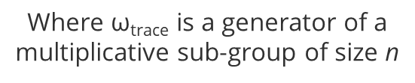





STARK domains
Evaluation domain D_{lde}
Trace domain D_{trace}
$${\text{ω}}_{lde}^{0}$$
$${\text{ω}}_{trace}^{0}$$
4x blowup
$${\text{ω}}_{trace}^{n}$$
$${\text{ω}}_{trace}^{1}$$
$${\text{ω}}_{lde}^{4n}$$
$${\text{ω}}_{lde}^{4}$$
$${\text{ω}}_{trace}^{2}$$
$${\text{ω}}_{lde}^{8}$$
Where $\text{ω}\text{trace}$ is a generator of a multiplicative sub-group of size n
Where ${\text{ω}}_{lde}^{4}$ = $\text{ω}\text{tr}\text{a}\text{ce}$

Slide 31







Fibonacci domains
$${\text{ω}}_{2}=4194304000$$
$${\text{ω}}_{32}=2906399817$$
$${\text{ω}}_{64}=369001549$$
$$1, 369001549, {369001549}^{2},{369001549}^{3}, . . . ,{369001549}^{63}=D_{trace}$$
$${\text{ω}}_{128}=2026377158$$
$${\text{ω}}_{256}=1867760616$$
$${\text{ω}}_{512}=3185713831$$
$$1, 3185713831, {3185713831}^{2},{3185713831}^{3}, . . . ,{3185713831}^{511}{=D}_{lde}$$
$${\text{ω}}_{2^{25}}=1177770062$$

Slide 32
Outline
Proving systems
Use cases and applications
Demystifying STARKs
Execution trace
Low-degree extensions
Constraint evaluation
FRI
STARK-based virtual machines

Slide 33
Constraints: general idea
Define algebraic relationships between registers of the execution trace.
Reinterpret these relationships as polynomials with roots at points where relationships hold.
Divide out roots from constraint polynomials to convert them into rational constraints.

Slide 34
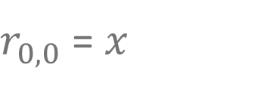



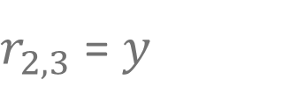
Types of constraints
Transition Constraints
Describe algebraic relationships between two or more steps of the computation.
r₀
r₁
r₂
r₃
$r_{0,0}$ = $x$
s₀
x
$$f\left(s_{0},s_{1}\right)=0$$
s₁
$f\left(s_{1},s_{2}\right)=$ $0$
Boundary Constraints
Assert values of specific registers at specific steps in the computation.
s₂
$f\left(s_{2},s_{3}\right)=$ $0$
$r_{2,3}$ = $y$
s₃
y

Slide 35

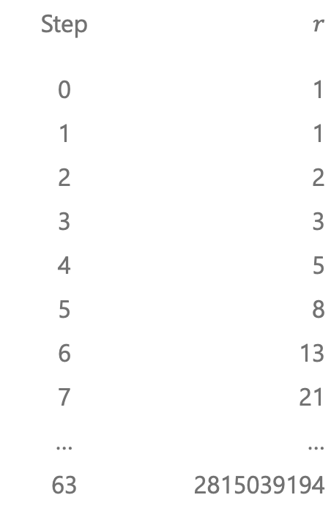
Fibonacci constraints
Step | $$r$$
0 | 1
1 | 1
2 | 2
3 | 3
4 | 5
5 | 8
6 | 13
7 | 21
… | …
63 | 2815039194
Transition constraints
$$r_{i+2}=r_{i+1}+r_{ i}$$

Slide 36
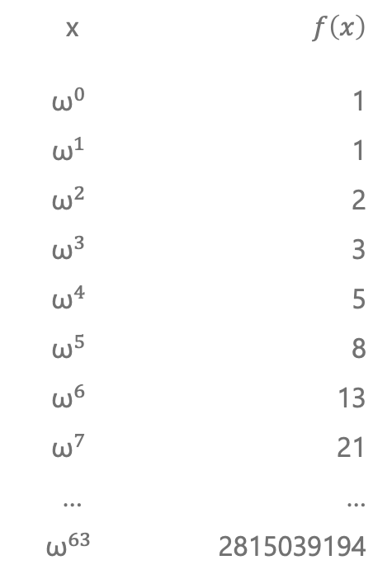
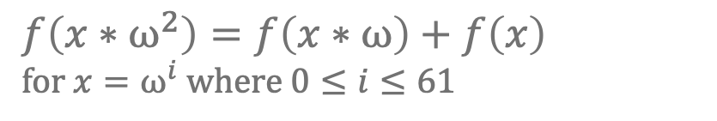
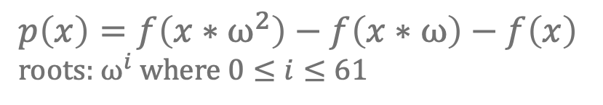
Fibonacci constraints
x | $$f\left(x\right)$$
$${\text{ω}}^{0}$$ | 1
$${\text{ω}}^{1}$$ | 1
$${\text{ω}}^{2}$$ | 2
$${\text{ω}}^{3}$$ | 3
$${\text{ω}}^{4}$$ | 5
$${\text{ω}}^{5}$$ | 8
$${\text{ω}}^{6}$$ | 13
$${\text{ω}}^{7}$$ | 21
… | …
$${\text{ω}}^{63}$$ | 2815039194
Transition constraints
$$r_{i+2}=r_{i+1}+r_{ i}$$
$$f\left(x∗{\text{ω}}^{2}\right)=f\left(x∗\text{ω}\right)+f\left(x\right)$$
for $x={\text{ω}}^{i}$ where $0≤i≤61$
$$p\left(x\right)=f\left(x∗{\text{ω}}^{2}\right)−f\left(x∗\text{ω}\right)−f\left(x\right)$$
roots: ${\text{ω}}^{i}$ where $0≤i≤61$

Slide 37
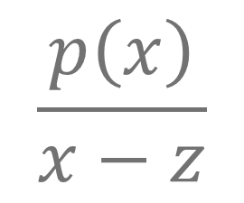

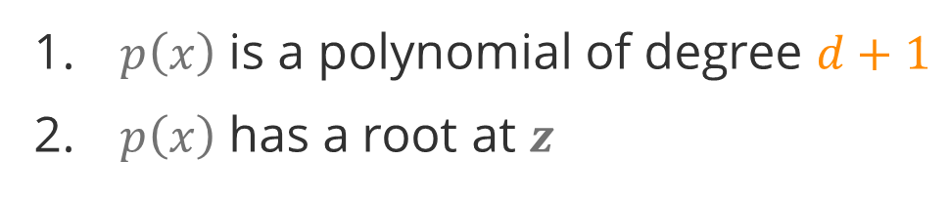
Polynomial divisibility
$$\frac{p\left(x\right)}{x−z}$$
is a polynomial of degree $d$ if and only if:
$p\left(x\right)$ is a polynomial of degree $d+1$
$p\left(x\right)$ has a root at $z$

Slide 38
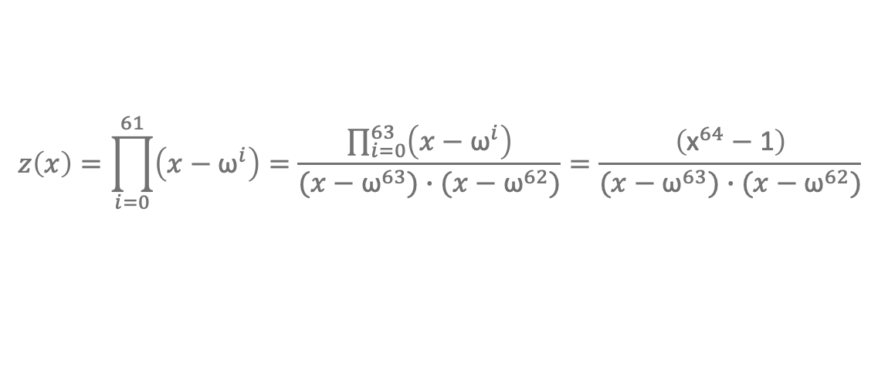
Divisor polynomial
$$z\left(x\right)=\left(x−{\text{ω}}^{0}\right)∙\left(x−{\text{ω}}^{1}\right)…\left(x−{\text{ω}}^{61}\right)$$
product of all divisors of $p\left(x\right)$
$$z\left(x\right)=\prod_{i=0}^{61}{\left(x−{\text{ω}}^{i}\right)}=\frac{\prod_{i=0}^{63}{\left(x−{\text{ω}}^{i}\right)}}{(x−{\text{ω}}^{63})∙(x−{\text{ω}}^{62})}=\frac{\left({\text{x}}^{64}−\text{1}\right)}{(x−{\text{ω}}^{63})∙(x−{\text{ω}}^{62})}$$
Can be efficiently computed by the verifier

Slide 39







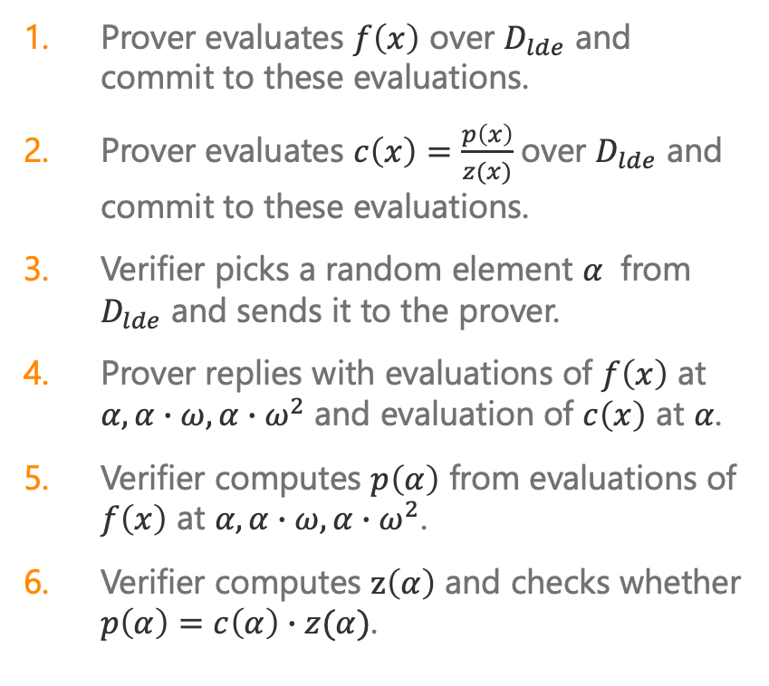










Prover-verifier interaction
Prover evaluates $f\left(x\right)$ over $D_{lde}$ and commit to these evaluations.
Prover evaluates $c\left(x\right)=\frac{p\left(x\right)}{z(x)}$ over $D_{lde}$ and commit to these evaluations.
Verifier picks a random element $α$ from $D_{lde}$ and sends it to the prover.
Prover replies with evaluations of $f\left(x\right)$ at $α,α∙ω,α∙ω^{2}$ and evaluation of $c\left(x\right)$ at $α$.
Verifier computes $p\left(α\right)$ from evaluations of $f\left(x\right)$ at $α,α∙ω,α∙ω^{2}$.
Verifier computes $z\left(α\right)$ and checks whether $p\left(α\right)=c\left(α\right)∙z(α)$.
Prover
Verifier
$$f:D_{lde}→F$$
$$f_{0}$$
$$f_{1}$$
$$f_{2}$$
$$f_{3}$$
$$f_{4}$$
$$f_{5}$$
…
$$\text{…}$$
$$c:D_{lde}→F$$
$$c_{0}$$
$$c_{1}$$
$$c_{2}$$
$$c_{3}$$
$$c_{4}$$
$$c_{5}$$
…
$$\text{…}$$
$$α$$
$$f\left(α\right), f\left(α∗ω\right), f\left(a∗ω^{2}\right), c\left(α\right)$$

Slide 40
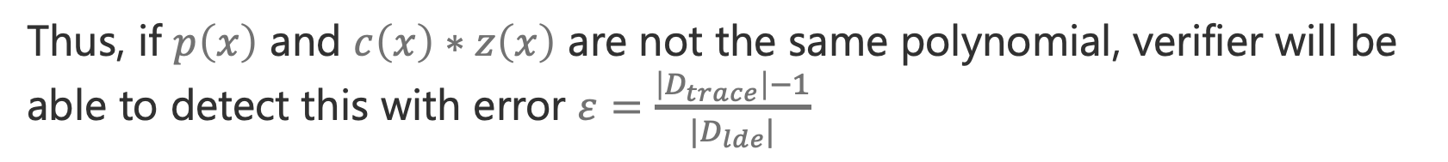
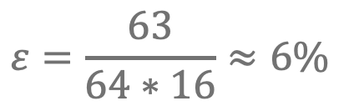
Proof soundness
Fact: two distinct degree $d$ polynomials agree on at most $d$ points
$$\deg\left(p\left(x\right)\right)=\deg\left(c\left(x\right)∗z\left(x\right)\right)=\left|D_{trace}\right|−1$$
Thus, if $p\left(x\right)$ and $c\left(x\right)∗z\left(x\right)$ are not the same polynomial, verifier will be able to detect this with error $ε=\frac{\left|D_{trace}\right|−1}{|D_{lde}|}$
$$ε=\frac{63}{64∗16}≈6\%$$
24 queries are needed to achieve 100-bit security level

Slide 41
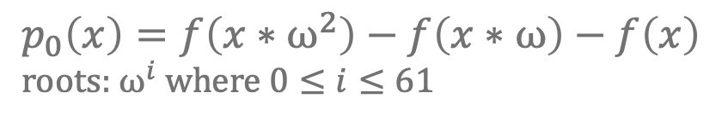
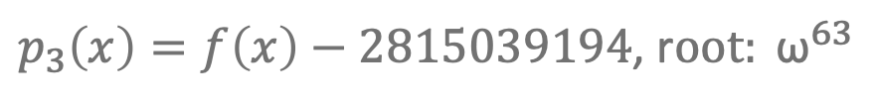
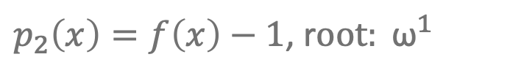
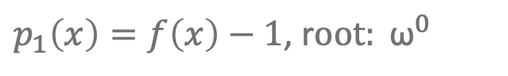
Fibonacci constraints
x | $$f\left(x\right)$$
$${\text{ω}}^{0}$$ | 1
$${\text{ω}}^{1}$$ | 1
$${\text{ω}}^{2}$$ | 2
$${\text{ω}}^{3}$$ | 3
$${\text{ω}}^{4}$$ | 5
$${\text{ω}}^{5}$$ | 8
$${\text{ω}}^{6}$$ | 13
$${\text{ω}}^{7}$$ | 21
… | …
$${\text{ω}}^{63}$$ | 2815039194
Transition constraints
$$p_{0}\left(x\right)=f\left(x∗{\text{ω}}^{2}\right)−f\left(x∗\text{ω}\right)−f\left(x\right)$$
roots: ${\text{ω}}^{i}$ where $0≤i≤61$
Boundary constraints
$p_{1}\left(x\right)=f\left(x\right)−1$, r$oot: {\text{ω}}^{0}$
$p_{2}\left(x\right)=f\left(x\right)−1$, r$oot: {\text{ω}}^{1}$
$p_{3}\left(x\right)=f\left(x\right)−2815039194$, r$oot: {\text{ω}}^{63}$

Slide 42
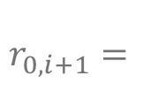

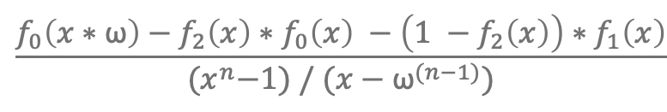
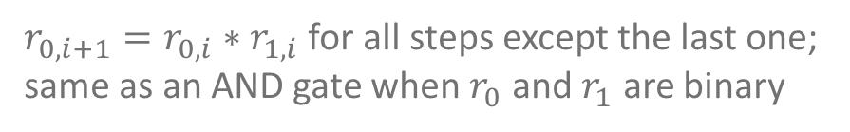
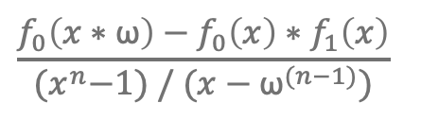

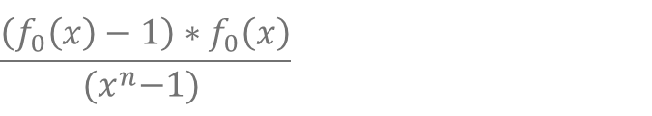

Constraint examples
$$\frac{\left(f_{0}\left(x\right)−1\right)∗f_{0}\left(x\right)}{{\text{(}x}^{n}−1) }$$
All values in $r_{0}$ must be binary – i.e. 0 or 1.
$$\frac{f_{0}\left(x∗\text{ω}\right)−f_{0}\left(x\right)∗f_{1}\left(x\right)}{{\text{(}x}^{n}−1) / (x−{\text{ω}}^{(n−1)})}$$
$r_{0, i+1}=r_{0, i}∗r_{1, i}$ for all steps except the last one; same as an AND gate when $r_{0}$ and $r_{1}$ are binary
$$\frac{f_{0}\left(x∗\text{ω}\right)−f_{2}\left(x\right)∗f_{0}\left(x\right) −\left(1 −f_{2}\left(x\right)\right)∗f_{1}\left(x\right)}{{\text{(}x}^{n}−1) / (x−{\text{ω}}^{(n−1)})}$$
$$r_{0, i+1}=$$
$r_{0, i}$ when $r_{2, i}=1$
for all steps except the last one
$r_{1, i}$ when $r_{2, i}=0$

Slide 43
Outline
Proving systems
Use cases and applications
Demystifying STARKs
Execution trace
Low-degree extensions
Constraint evaluation
FRI
STARK-based virtual machines

Slide 44
FRI: testing polynomiality
function:
$$f\left(x\right)=c_{0}+c_{1}∙x+c_{2}∙x^{2}+…+c_{k}∙x^{k−1}$$
domain:
$\text{D}\text{ = 1, }\text{ω}\text{, }{\text{ω}}^{2},$…, ${\text{ω}}^{8 ∗k−1}$
evaluations:
$f\text{: }\text{D} →F\text{=}{ e}_{0}\text{,} e_{1}\text{,}{ e}_{2},$…,$e_{8∗k−1}$
Prover convinces the verifier that $f\text{: }\text{D} →F$ are evaluations of a polynomial of degree less than $k$ by sending over only $O(\log{k})$evaluations

Slide 45
Degree-respecting projection
$f\left(x\right)$ evaluated over D
$$f\left(x\right)=c_{0}+c_{1}∗x+c_{2}∗x^{2}+c_{3}∗x^{3}$$
$$f\left(x\right)=\left(c_{0}+c_{2}∗x^{2}\right)+x ∗(c_{1}+c_{3}∗x^{2})$$
$$α$$
DRP
$$g\left(x\right)=\left(c_{0}+c_{2}∗x^{2}\right), h\left(x\right)= (c_{1}+c_{3}∗x^{2})$$
from verifier
$$g\left(y\right)=\left(c_{0}+c_{2}∗y\right), h\left(y\right)= (c_{1}+c_{3}∗y)$$
$$f^{′}(y)=g\left(y\right)+α ∗h(y)$$
$f^{′}(y)$ evaluated over D’
$$f^{′}\left(y\right)=\left(c_{0}+α∗c_{1}\right)+\left(c_{2}+α{∗c}_{3}\right)∗y$$

Slide 46
Degree-respecting projection
$$f\left(−x\right)$$
$$f\left(x\right)$$
$$f\left(x\right)=c_{0}+c_{1}∗x+c_{2}∗x^{2}+c_{3}∗x^{3}$$
$$f\left(x\right)=\left(c_{0}+c_{2}∗x^{2}\right)+x ∗(c_{1}+c_{3}∗x^{2})$$
$$α$$
DRP
$$g\left(x\right)=\left(c_{0}+c_{2}∗x^{2}\right), h\left(x\right)= (c_{1}+c_{3}∗x^{2})$$
from verifier
$$g\left(y\right)=\left(c_{0}+c_{2}∗y\right), h\left(x\right)= (c_{1}+c_{3}∗y)$$
$$f^{′}(y)=g\left(y\right)+α ∗h(y)$$
$$f^{′}\left(y\right)$$
$$f^{′}\left(y\right)=\left(c_{0}+α∗c_{1}\right)+\left(c_{2}+α{∗c}_{3}\right)∗y$$

Slide 47
Prover-verifier interaction
Prover evaluates $f\left(x\right)$ over $D$ and commit to these evaluations.
Verifier picks a random element $α_{1}$ from the entire field and sends it to the prover.
Prover computes DRP of $f\left(x\right)$ and commits to its evaluations over $D^{′}$.
This repeats until the remaining polynomial is small enough, at which point the prover send the whole polynomial to the verifier.
The verifier picks random query positions from $D$ and send them to the prover.
Prover sends decommitments for the specified positions from all layers.
Verifier checks that DRPs were computed correctly and that the remainder polynomial matches expected degree.
Prover
Verifier
Commit to $f\text{: }\text{D} →F$
$$α_{1}$$
Commit to $f′\text{: }{\text{D}}^{′} →F$
$$α_{2}$$
Commit to $f′′\text{: }{\text{D}}^{′′} →F$
Query positions
Decommitments

Slide 48
Outline
Proving systems
Use cases and applications
Demystifying STARKs
STARK-based virtual machines
Toy VM example

Slide 49
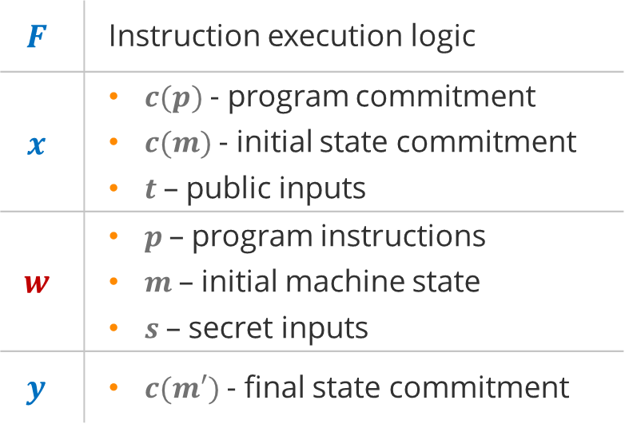

Virtual machine definition
Virtual machine
$$F$$ | Instruction execution logic
$$x$$ | $c(p)$- program commitment $c(m)$ - initial state commitment $t$ – public inputs
$$w$$ | $p$ – program instructions $m$ – initial machine state $s$ – secret inputs
$$y$$ | $c(m′)$ - final state commitment
$$F\left(x, w\right)=y$$

Slide 50
VM design considerations
Machine type
Stack machine
Register machine
Memory-memory machine
Flow control
Harvard architecture
von Neumann architecture
Merkelized abstract syntax tree (MAST)
Program input
Program hash
Public memory
Codeword commitment
Function calls
Static vs. dynamic call targets
Memory model
Write-once vs. read-write memory
Addressing model
Native data types
Field elements
Regular integers (e.g., u32)
Structs, arrays, sets etc.
Native field
64-bit vs. 128-bit vs. 256-bit

Slide 51
Outline
Proving systems
Use cases and applications
Demystifying STARKs
STARK-based virtual machines
Toy VM example

Slide 52
Toy VM example
Operation | Op Code
NOOP | 0
PUSH | 1
ADD | 2
MUL | 4
h₀
h₁
h₂
h₃
c
f₀
f₁
f₂
s₀
s₁
s₂
s₃
Instruction sponge
Op code
Operation flags
Stack

Slide 53
Program execution
h₀
h₁
h₂
h₃
c
f₀
f₁
f₂
s₀
s₁
s₂
s₃
0
0
0
0
0
0
0
0
0
0
0
0
Operation | Op Code
NOOP | 0
PUSH | 1
ADD | 2
MUL | 4
PUSH 3
1
3
-
-
1
1
0
0
3
0
0
0
PUSH 5
1
5
-
-
1
1
0
0
5
3
0
0
ADD
2
0
-
-
2
0
1
0
8
0
0
0

Slide 54

Constraints
Op flags must be binary
$$f_{i}^{2}−f_{ i}=0$$
Row_{n}
h₀
h₁
h₂
h₃
c
f₀
f₁
f₂
s₀
s₁
s₂
s₃
Op flags must be consistent with Op code
Row_{n+1}
h'₀
h'₁
h'₂
h'₃
c'
f'₀
f'₁
f'₂
s'₀
s'₁
s'₂
s'₃
$$c−(f_{ 0}+2∗f_{ 1}+4∗f_{ 2})=0$$
Only one Op flag can be set at a time
$$1−\left(f_{ 0}+f_{ 1}+f_{ 2}\right)−\left(1−f_{ 0}\right)∗\left(1−f_{ 1}\right)∗(1−f_{ 2})=0$$
Top stack item must be updated based on Op flags
$$s_{0}^{′}−f_{0}^{′}∗h_{ 1}−f_{1}^{′}∗\left(s_{ 0}+s_{1}\right)−f_{2}^{′}∗s_{ 0}∗s_{ 1}−\left(1−f_{0}^{′}−f_{1}^{′}−f_{2}^{′}\right)∗s_{ 0}=0$$
PUSH
ADD
MUL
NOOP

Slide 55
Appendix

Slide 56
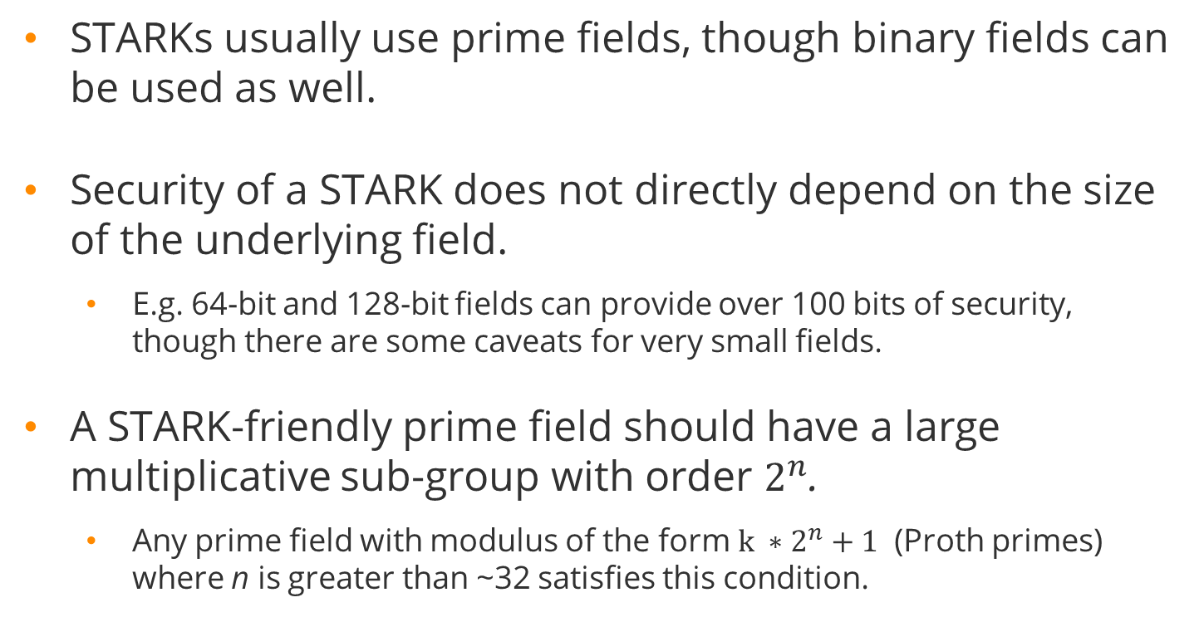
STARK fields
STARKs usually use prime fields, though binary fields can be used as well.
Security of a STARK does not directly depend on the size of the underlying field.
E.g. 64-bit and 128-bit fields can provide over 100 bits of security, though there are some caveats for very small fields.
A STARK-friendly prime field should have a large multiplicative sub-group with order $2^{n}$.
Any prime field with modulus of the form $k ∗2^{n}+1$ (Proth primes) where n is greater than ~32 satisfies this condition.

Slide 57
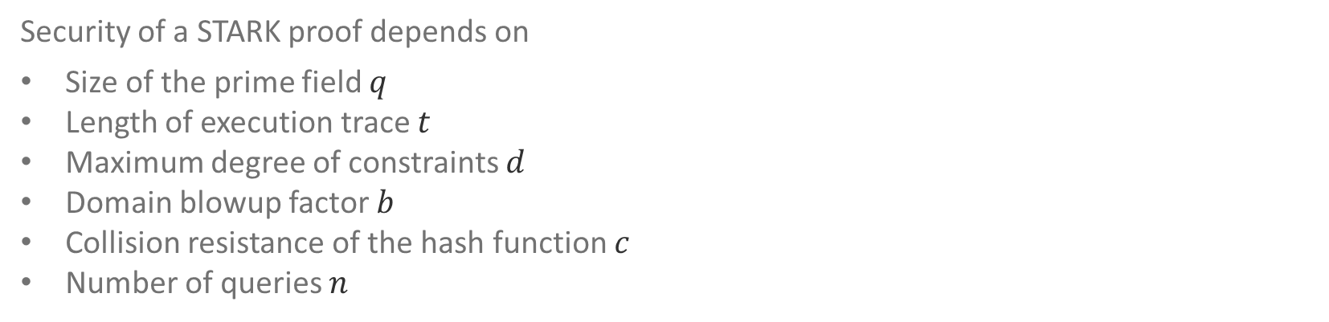
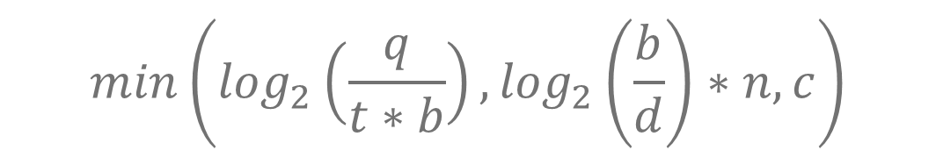
STARK security level
Security of a STARK proof depends on
Size of the prime field $q$
Length of execution trace $t$
Maximum degree of constraints $d$
Domain blowup factor $b$
Collision resistance of the hash function $c$
Number of queries $n$
$$min\left(\log_{2}\left(\frac{q}{t∗b}\right),\log_{2}\left(\frac{b}{d}\right)∗n, c\right)$$

Slide 58
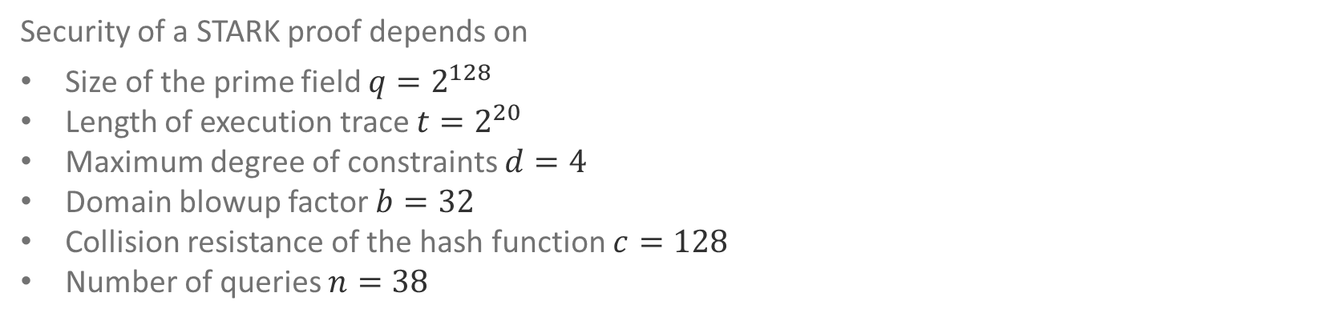

STARK security level example
Security of a STARK proof depends on
Size of the prime field $q=2^{128}$
Length of execution trace $t=2^{20}$
Maximum degree of constraints $d=4$
Domain blowup factor $b=32$
Collision resistance of the hash function $c=128$
Number of queries $n=38$
$$min\left(\log_{2}\left(\frac{2^{128}}{2^{25}}\right),\log_{2}\left(\frac{32}{4}\right)∗38, 128\right)=\min\left(113, 114, 128\right)=113$$

Slide 59
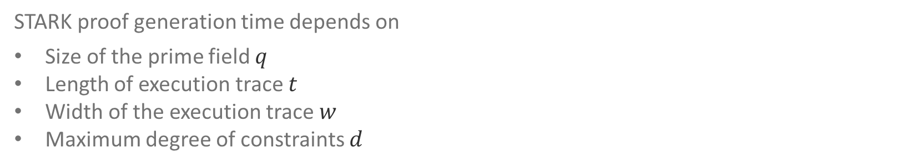

STARK prover complexity
STARK proof generation time depends on
Size of the prime field $q$
Length of execution trace $t$
Width of the execution trace $w$
Maximum degree of constraints $d$
$${\left(\frac{\log_{2}q}{64}\right)}^{2}∗\left(d+w\right)∗t∗\log_{2}t$$

